Slide 1
PBHS 31001 – Epidemiologic Methods
Winter 2024
Stata Session #3
Adapted from previous TAs’ slides

Slide 2
Topics
Cohort study command (cs)
Case-control study command (cc)
Incidence rate ratio (ir)
Linear regression model (reg)

Slide 3
Dataset
Let’s use the Framingham data.
Key variables:
mi_fchd: Hospitalized Myocardial Infarction or Fatal Coronary Heart Disease (no/yes)
cursmoke: currently a cigarette smoker (no/yes)
timemifc: time to the first MI event during follow-up (days)
For groups with no event, this would be the time up to the end of follow-up.
Notes:
Will use the Framingham dataset
Review some commands previously used
Generate, replace, recode (if, and, or, by)
tabstat & bysort
Hypothesis testing

Slide 4
Cohort Study command
The cs command is useful when you analyze data from a cohort study
Assuming equal or complete follow-up time
Also useful for cross-sectional data (cs stands for “Cohort Study” or “Cross-Section study”)
cs [outcomeVar][exposureVar]
similar to the tab command, but with more information
tab [outcomeVar][exposureVar], chi
cc [outcomeVar][exposureVar] if [Var]

Slide 5
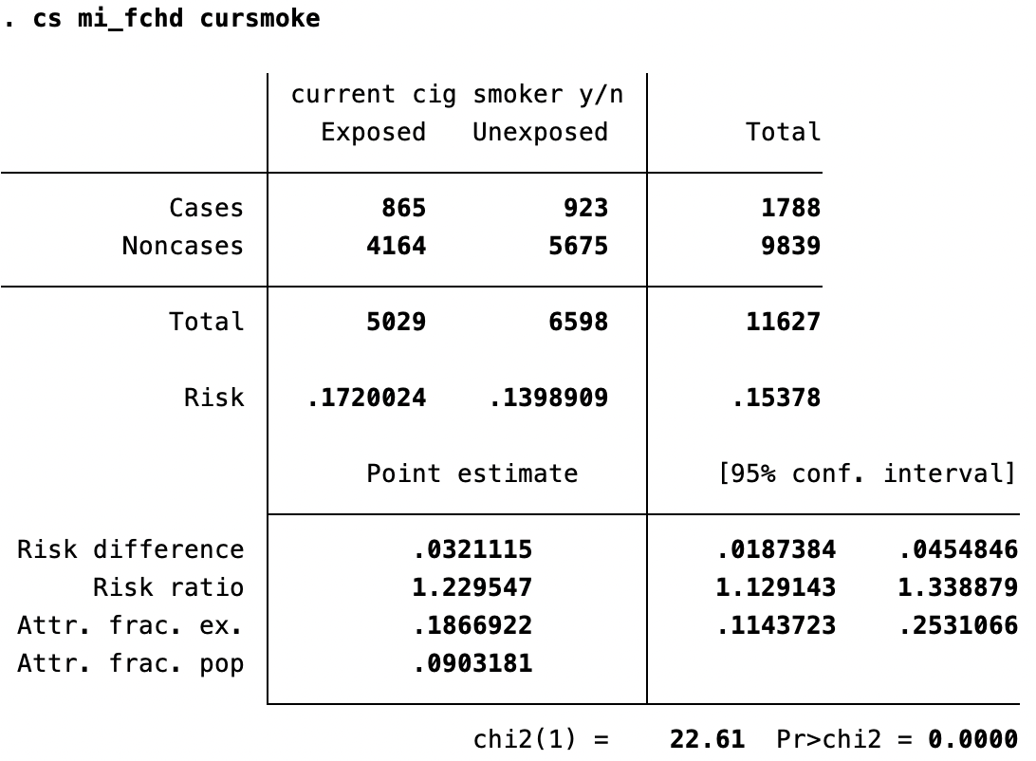

Slide 6
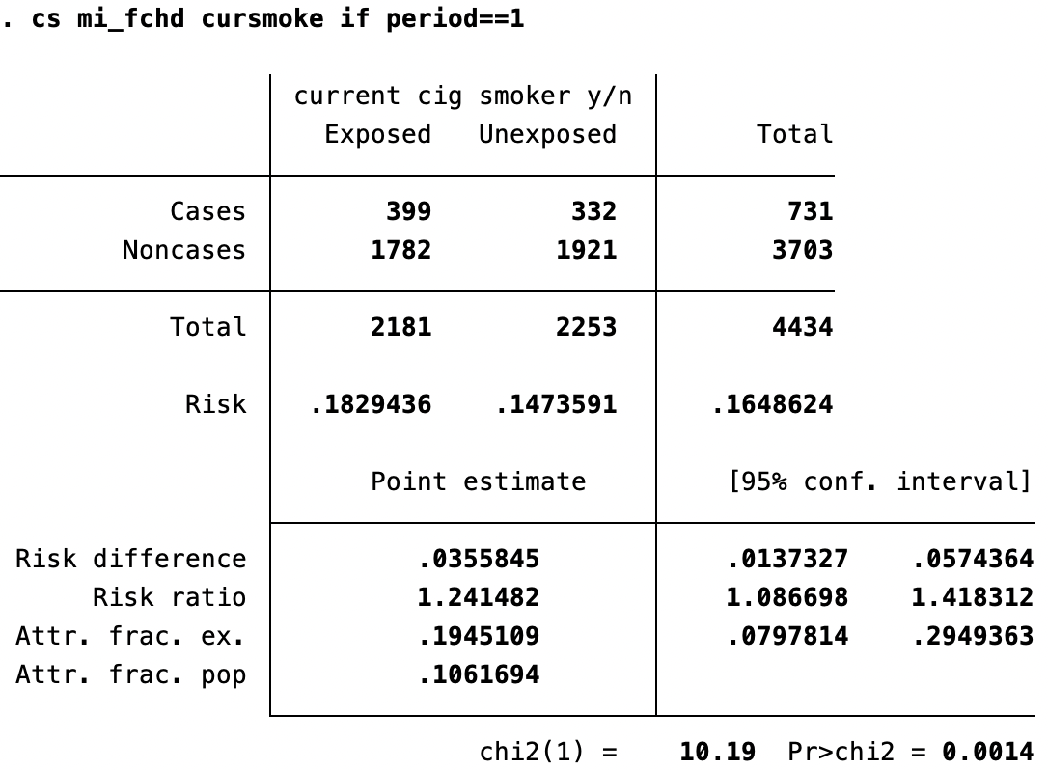
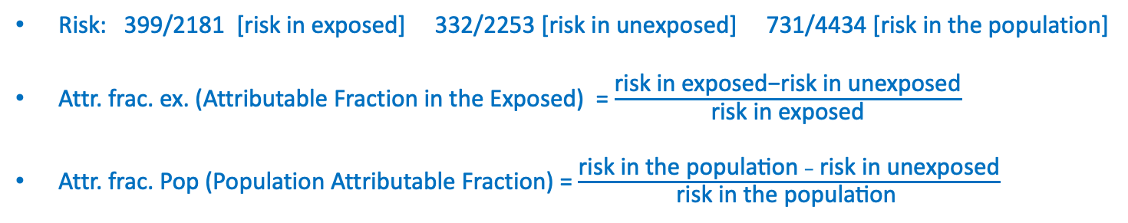

Slide 7
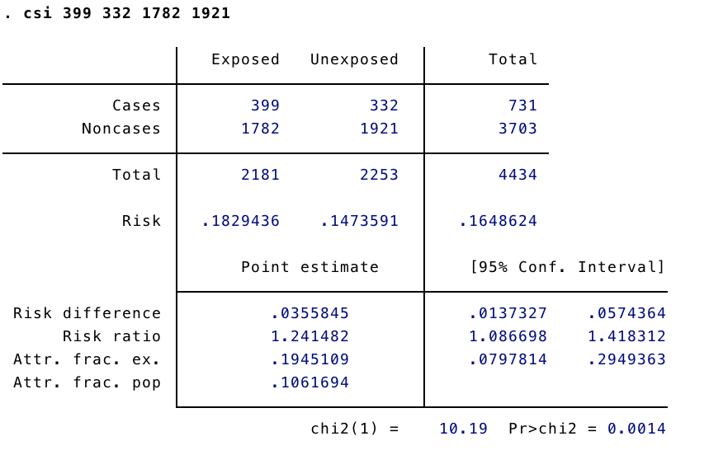
Cohort Study Command
Can use the cs command even if data is not loaded into Stata but make sure adding an “i”
csi [#exposedCases] [#unexposedCases] [#exposedNonCases] [#unexposedNonCases]

Slide 8
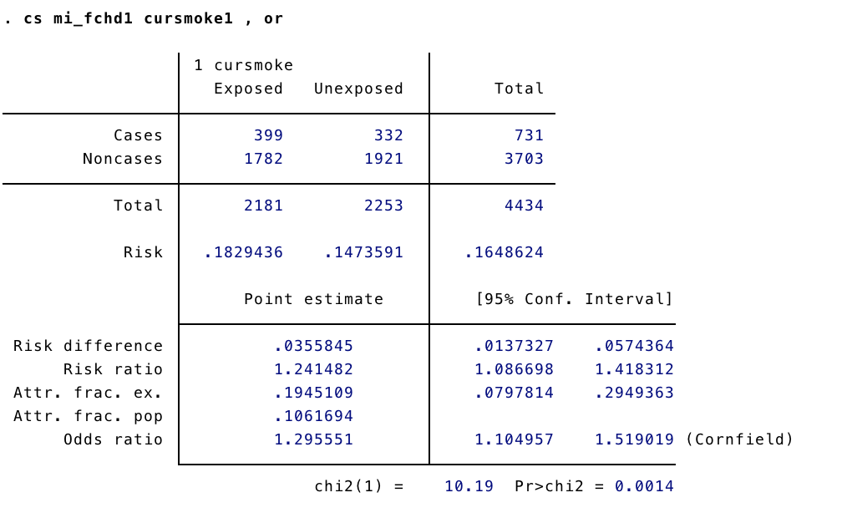
Cohort Study Command
Can also use the cs command to generate an odds ratio:
cs [outcomeVar][exposureVar], or

Slide 9
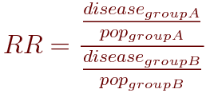
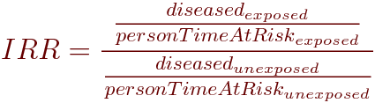
Incidence Rate Ratio (incidence density) Command
When using the cs command, we assume that follow-up time is equal
This is not the case in many studies including Framingham
The command ir allows you to incorporate differential follow-up time:
ir [outcomeVar][exposureVar][timeVar]
Instead of reporting:
It reports:

Slide 10
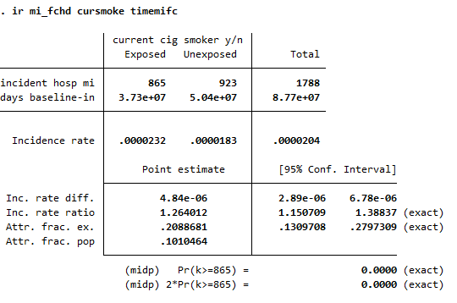
Incidence Ratio Command

Slide 11
Case-Control Study Command
The cc command is useful when you analyze data from a case-control study
Similar to cs command, but will report odds ratios, not risk ratios
Keep in mind: case-control studies can NOT produce risk estimates, only odds estimates
cc [outcomeVar][exposureVar]

Slide 12
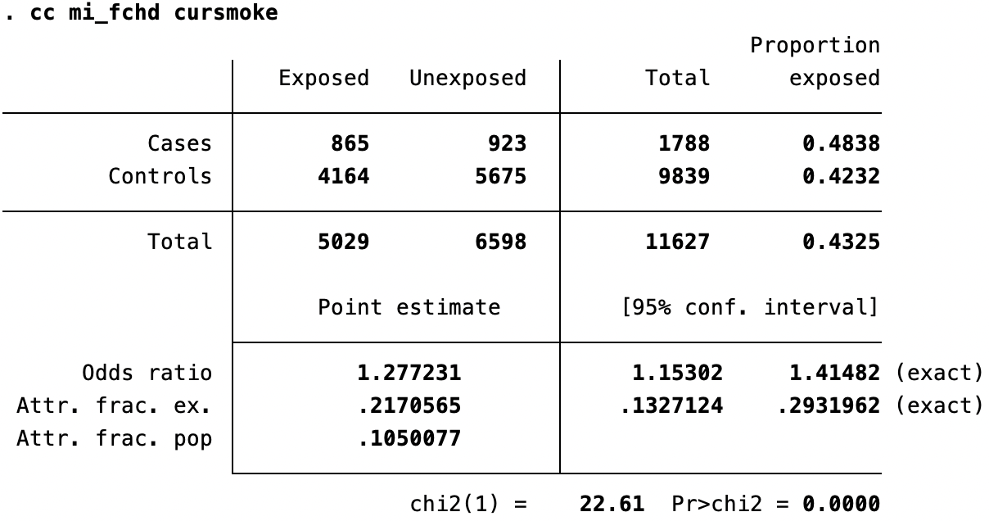
Cas-Control Study Command
How would you calculate the OR from this table?
cc [outcomeVar][exposureVar]

Slide 13
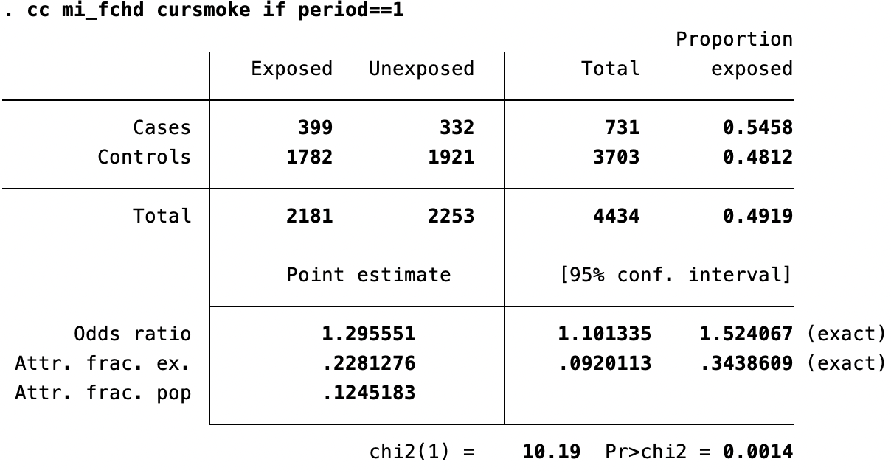
Case-Control Study Command
cc [outcomeVar][exposureVar] if [Var]
How would you calculate the OR from this table?

Slide 14
Case-Control Studies vs. Cohort Studies
Both case-control and cohort studies help illustrate the relationship between an exposure and a disease/outcome
Ultimately, most health questions want to be of the form “does exposure to X cause disease Y?”
Using data from cohort studies, you can answer this directly
Or at least “do people who have higher exposure to X get disease Y at a higher rate?”
Using data from case-control studies, the best you can do is ask
“are those with disease Y more likely to have been exposed to X?”
One practical takeaway is that case-control studies cannot estimate population rates of disease, but cohort studies can

Slide 15
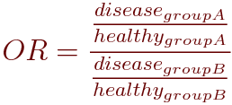
Cohort Studies vs. Case-Control Studies
Cohort | Case-Control
Can estimate population rates of disease for different levels of exposures | Can NOT estimate population rates/risk (but odds) of disease for different levels of exposure
Begin with exposure and follow people to measure disease occurrence/incidence | Begin with disease and investigate retrospectively to ascertain exposure(s)
Good for rare exposures | Good for rare diseases
Can calculate RR, IRR, and OR | Can calculate OR only
Can study multiple outcomes | Can study multiple exposures

Slide 16
Why Regression Models
Stratified analysis using tabular and graphical method
Easy to be interpreted
Limits of # of variables
Only categorical predictors
Regression models
Simultaneously handle multiple variables
Sometime difficult to interpret

Slide 17
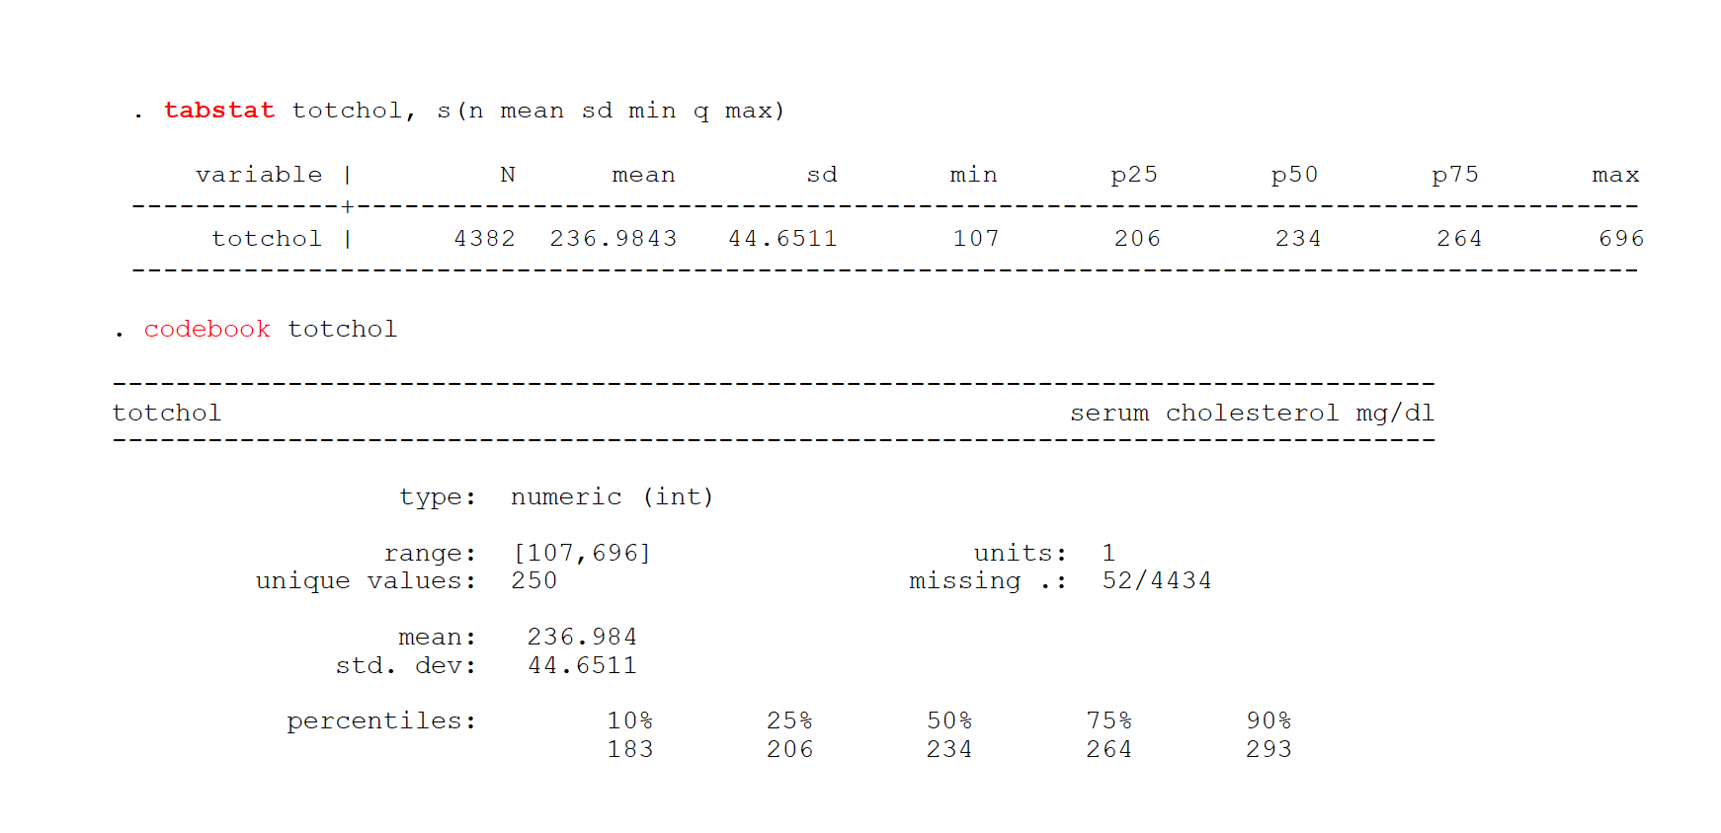
Linear Regression Modeling
The dependent variable is continuous
Let’s recall how we might examine this in Stata
Notes:
There are many ways to model. How people choose to treat variables might be different. But need to justify.
Some unaccepted ones:
treat categorical variable as continuous
Treat nominal variable ordinal

Slide 18
Linear Regression Modeling
Syntax: reg
reg [outcomeVar][exposureVar][covariate1]…[covariate2]

Slide 19
Linear regression: types of variables
In contrast to simpler stratified methods, regression allows a common framework for incorporating many types of variables in one model
Types of predictor variables
Categorical (Binary/Dichotomous, nominal)
Ordinal
Continuous
transformed
quadratic
Sometimes you have no choice in how to present a variable (if it is collected dichotomous or categorical). If it is continuous or ordinal, you do have choices.

Slide 20
Some Research Questions
Research questions: Could BMI predicts total cholesterol? At what range of BMI, should we test for total cholesterol in the population?
Analysis questions:
How should we model total cholesterol?
What is our expectation of the relationship?
Are there any variables that confound the relationship between cholesterol and BMI?
Does the relationship between cholesterol and BMI depend on a third factor?

Slide 21
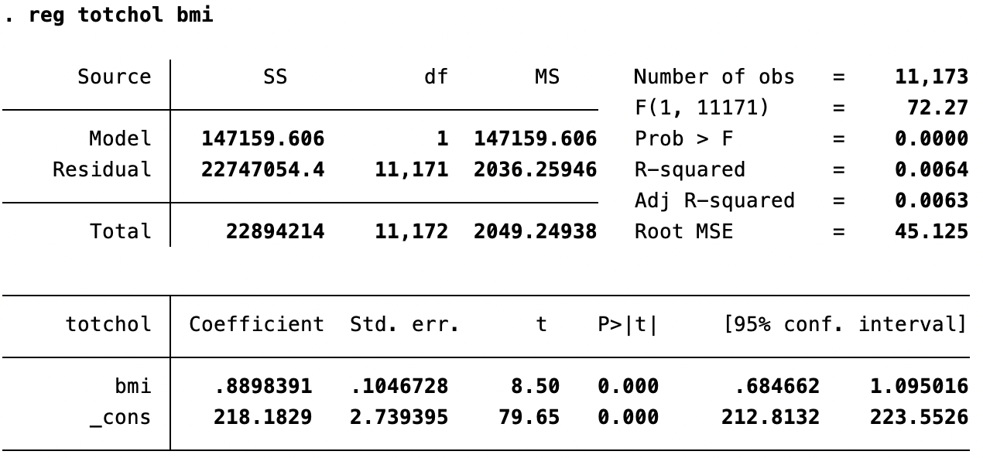
Simple Linear Regression

Slide 22
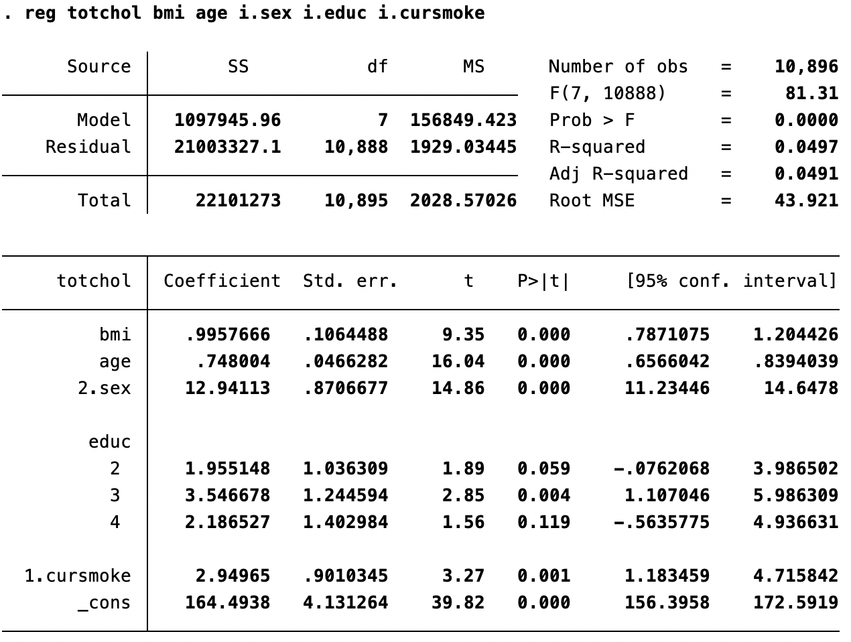
Multivariable Linear Regression

